Slide 1
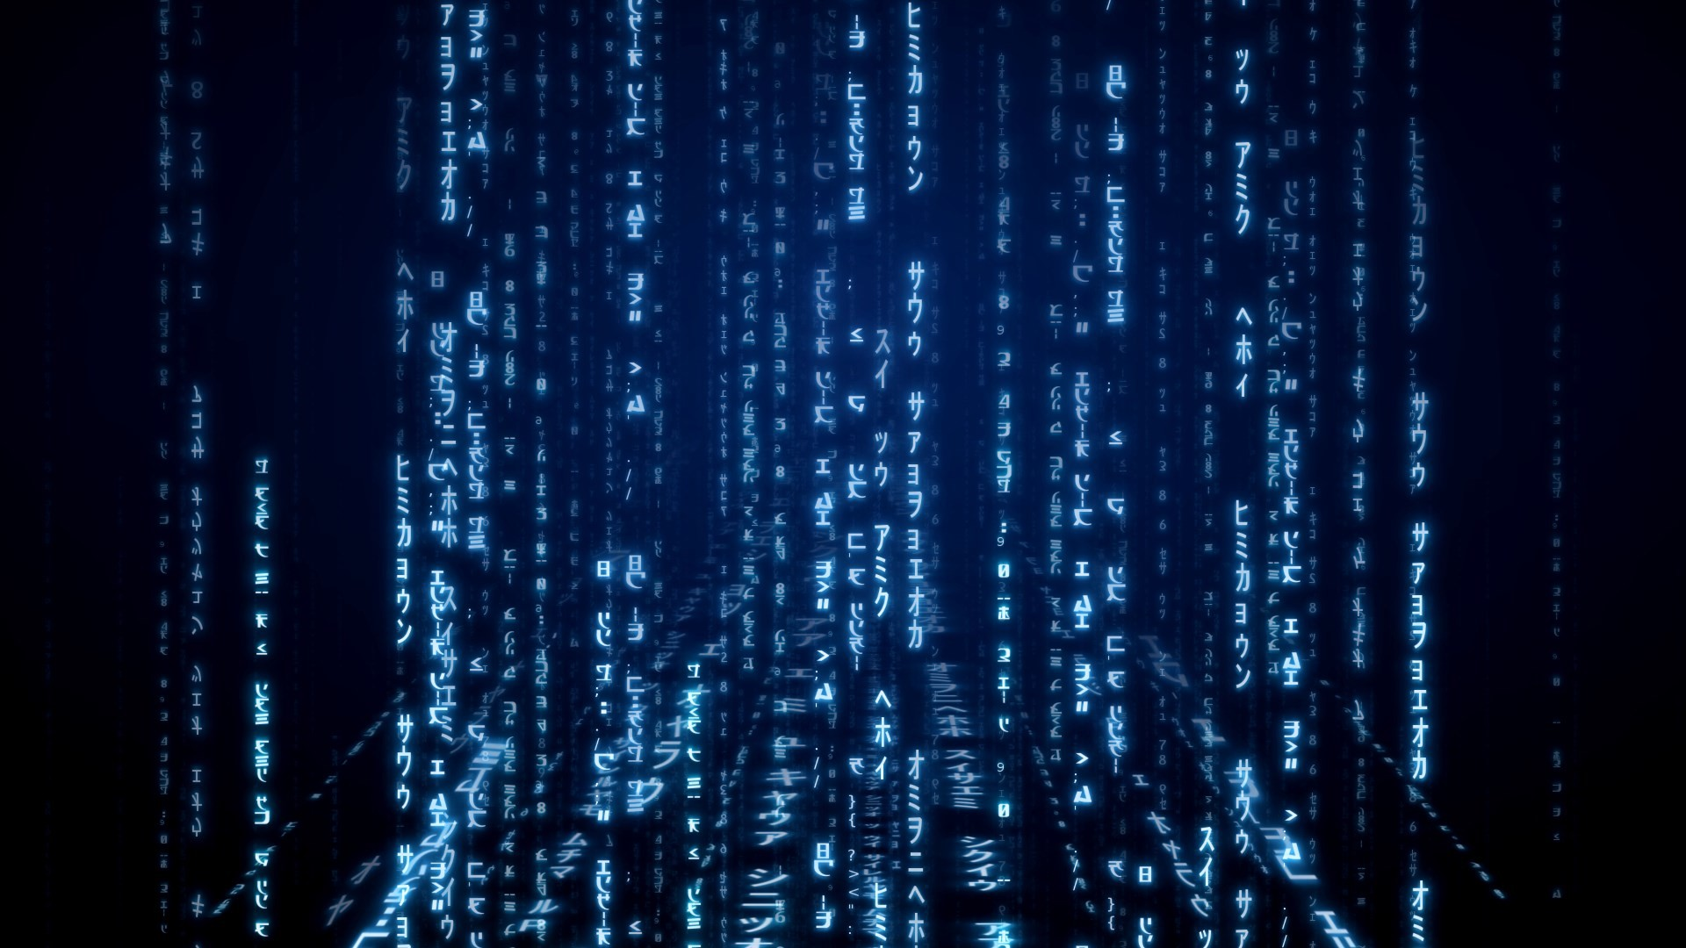
SEICHE 2022 Introduction to Arduino Lesson 3 – Intro Part 3
Instructor: Paul Frommeyer
Corporate Sponsors
DXC Technology
PFC Networks

Slide 2
Lesson Plan Overview
Lesson 1 – Intro and Setup
[may require 2 classes]
• Introduction to class format
• Overview of lesson plan
• Presentation format (monitor, camera, screen, whiteboard)
• Inventory of Arduino kits
• Inventory of USB drives
• Installation of ESP32 serial port drivers (Windows only)
• Installation of Arduino software
• History of Computing
Lesson 2 – Laptop operation review
• Control panel/Settings location
• Home directories and folder hierarchy
• Arduino file locations
• Search functions
• Open questions and issues
• History of Computing redux
Lesson 3 – IDE essentials
• Setting board type
• Loading example sketches
• Finding and selecting the Arduino USB port
• Uploading a sketch to the microcontroller
• Basic Arduino sketch (program) structure
• History of Telecommunications and Networking
Lesson 4 – Computer Data Formats
• Binary math
• Basic data types
Lesson 4 – DC Electricity Basics and DMM Intro
• Quick review: DC vs AC electric currents
• DC current operation
• Voltage vs Amperage (current)
• Introduction to basic DMM functions and usage
• Series vs parallel circuits
• Ohm’s law Part 2
Lesson 5 – Elementary Components
• Resistors
• Diodes and LED’s
• Capacitors: Electrolytic (polarized) vs non-electrolytic (non-polarized)
• Simplified transistor operation
Lesson 6 – ESP32 External power sources [may require 2 classes]
• Microcontroller board power requirements
• Board power input options
• Components with different voltage requirements
• External power circuit design
Lesson 7 – Connecting LED’s to the ESP32 controller board
• Microcontroller pinouts and diagrams
• Different types of pins
• Analog input
• Digital Input
• Digital output
• LEDs, constant current, and dropping resistors
Lesson 8 – Connecting smart LED strips
• Simplified serial communication protocols
• One-wire serial communication protocol
• Hardware vs software serial
• WS2812B and Neopixel connections
• External device power design
Lesson 9 – Connecting Sensors
• I2C serial protocol
• I2C connections
• I2C sensor board power design
• I2C sensor external power design
Lesson 10 – Connecting LCD and Matrix Displays
• The SPI serial protocol
• SPI connections
• SPI device external power design
Lesson 11 – Connecting other sensors [time permitting]
• Connecting buttons
• Connecting potentiometers
• Reading buttons
• Reading potentiometers
Deferred until software programming class

Slide 3
Lesson 3 – Intro And Setup
Laptop Controls 1
Control panel/Settings location
Home directories and folder hierarchy
Arduino file locations
Search functions
Open questions and issues
History of Computing redux

Slide 4
Laptop GUI Operation
Laptop Controls 2
Desktop and task bar
Start menu and control/settings panels
Launching applications
Context sensitive menus (right click)
Filesystem browsers
File and folder hierarchies
Searching for applications
Accessign and safely removing flash drives
Outside class scope: Application usage other than Arduino IDE, operating system customization, anything command line or related

Slide 5
Operating System Settings
Laptop Controls 3
Windows 10 – Settings panel
Kubuntu – Settings panel
Finding applications
Modifying or adding user accounts
Command line access (CMD) – Windows
Command line access (Konsole) – Kubuntu
Device manager (Windows)
Listing USB devices (Kubuntu)
Checking disk space

Slide 6
File and Folder Hierarchies
File and Folder data storage model
Home directories
Arduino file locations
Accessing and safely removing flash drives

Slide 7
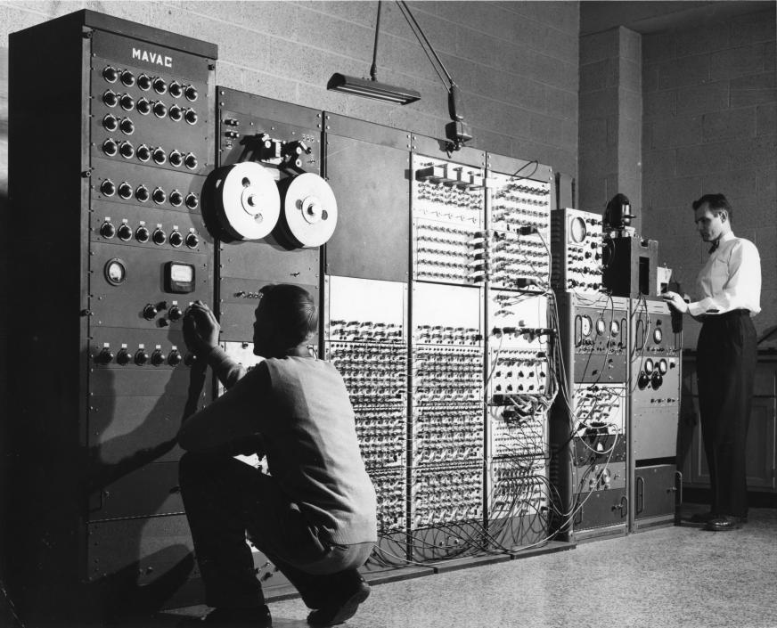
History of Computing
The Jacquard Loom
The Analytical Engine
ENIAC and MULTIVAC
The mainframe era
The minicomputer era
The microcomputer era
The market mitosis
Microcomputers
Microcontrollers
Microcomputer evolution
Microcontroller evolution

Slide 8
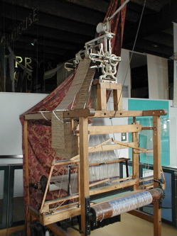
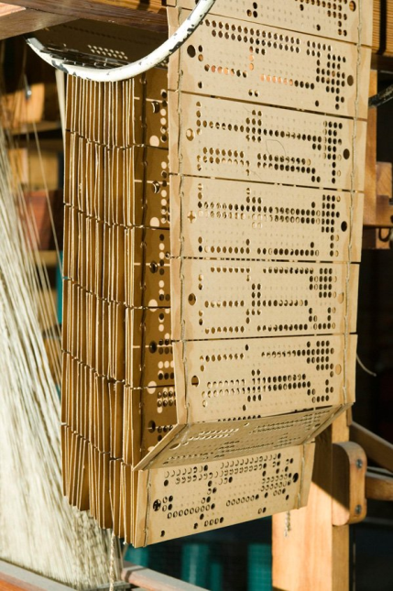
Jacquard Loom
Invented by Joseph Marie Jacquard in 1804
Technically, a Jacquard Machine which was attached to the heddles of an existing pattern loom
Provided automatic control of the heddles managing the warp threads
Used large punched cards to define the woven pattern
A hole in the card would cause that thread of the warp to be raised, thus excluded from the weft during a shuttle pass
Allowed extremely complex patterns to be woven
Once machine driven, gave rise to modern weaving industry
Mechanism still in use today, but electromechanical relay driven and controlled by digital computer

Slide 9
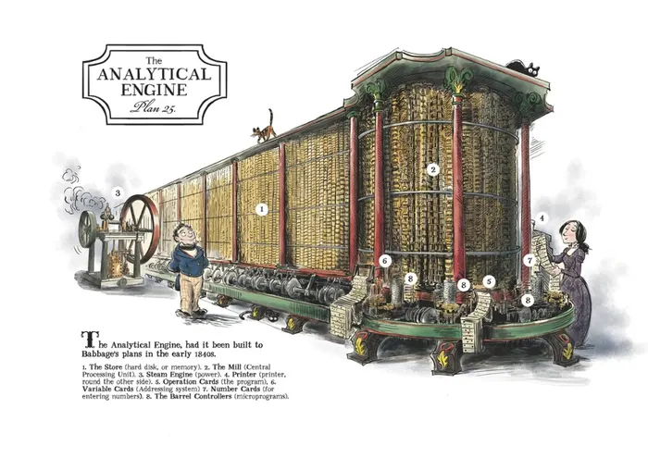
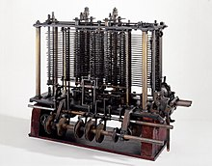
Babbage Analytical Engine
Invented by Charles Babbage, 1837
Construction was never completed
Four parts: Reader, store, mill, and printer
While using mechanical parts, was a programmable general purpose computer in the sense we understand
Considered a landmark invention in computer science
(Card) Reader(s)
Variable
Program
Store
Mill
Printer
Part of the Engine

Slide 10
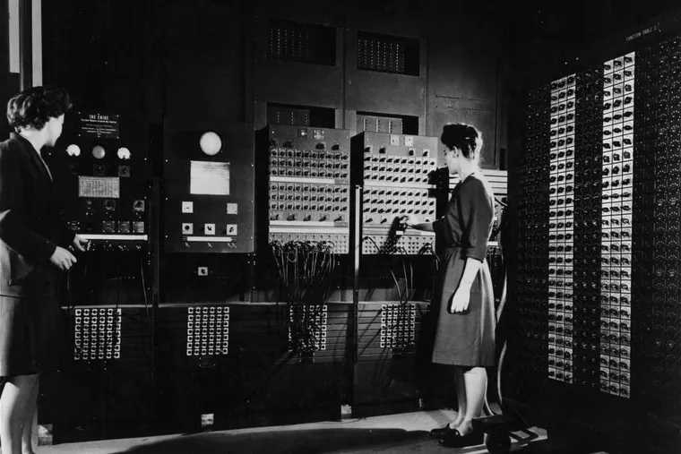
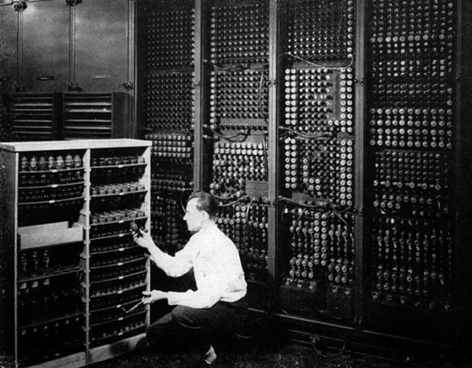
Early Computers – ENIAC
ENIAC - Electronic Numerical Integrator and Computer – was the first programmable, electronic, general-purpose digital computer made in 1945
By the end of its operation in 1956, ENIAC contained 18,000 vacuum tubes, 7,200 crystal diodes, 1,500 relays, 70,000 resistors, 10,000 capacitors, and approximately 5,000,000 hand-soldered joints. It weighed more than 30 short tons (27 t), was roughly 8 ft × 3 ft × 100 ft (2 m × 1 m × 30 m) in size, occupied 1,800 sq ft (170 m2) and consumed 150 kW of electricity.
ENIAC operator’s control board
Part of ENIAC

Slide 11
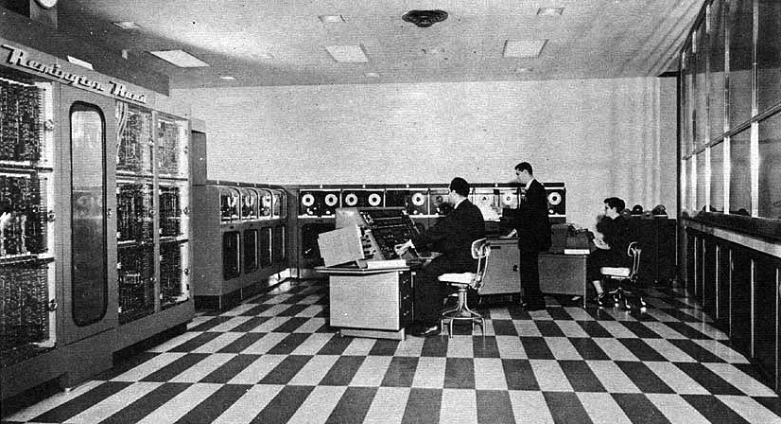
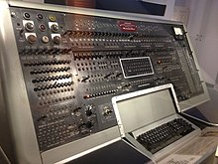
Early Computers – UNIVAC
UNIVAC I (UNIVersal Automatic Computer I) was the first general-purpose electronic digital computer design for business application produced in the United States
UNIVAC I used about 5,000 vacuum tubes,weighed 16,686 pounds, consumed 125 kW, and could perform about 1,905 operations per second running on a 2.25 MHz clock
Besides the operator's console, the only I/O devices connected to the UNIVAC I were up to 10 UNISERVO tape drives, a Remington Standard electric typewriter and a Tektronix oscilloscope. The UNISERVO was the first commercial computer tape drive commercially sold
Evolutionary rather than revolutionary
UNIVAC – Classic dieselpunk computing
UNIVAC Operator’s Console

Slide 12
Von Neumann Architecture
Earliest computers had fixed (hardwired) programs
Control storage (program) was originally separate from data storage (information to be operated upon)
John Von Neumann invented the idea of using a single storage medium for both instructions and data
This was a revolutionary design, reducing costs and increasing flexibility, and is used by all computers since
Instructions
Data
Main Memory
Central
Processor
Processor
Input/Output
(I/O)
Results
Historic Architecture
Von Neumann Architecture

Slide 13
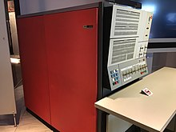
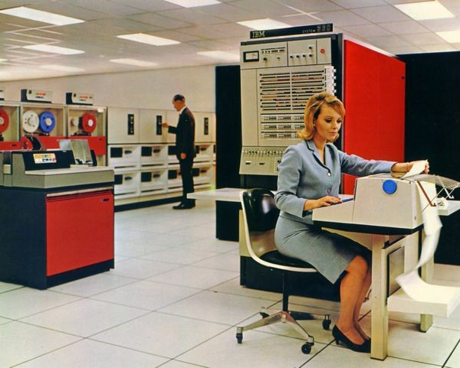
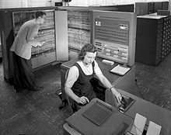
The Mainframe Era
From 1952 into the late 1960s, IBM manufactured and marketed several large computer models, known as the IBM 700/7000 series
The IBM System/360 (S/360) is a family of mainframe computer systems that was announced by IBM on April 7, 1964, and delivered between 1965 and 1978.[1] It was the first family of computers designed to cover the complete range of applications, from small to large, both commercial and scientific. The design made a clear distinction between architecture and implementation, allowing IBM to release a suite of compatible designs at different prices.
The mainframe era saw the transition from tubes to transistors, yielding massive economies of scale and increases in computing power
Also transition of storage from cumbersome mercury based to magnetic core memory
IBM System/360 CPU
IBM 700 Series
S/360 CPU and Peripherals

Slide 14
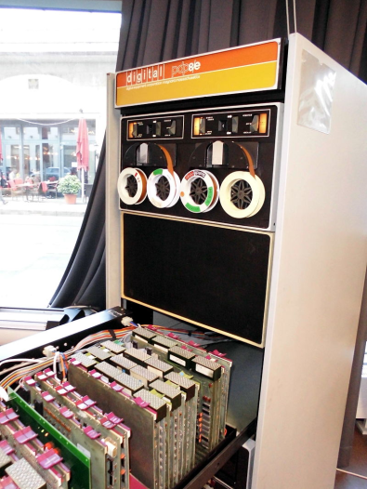
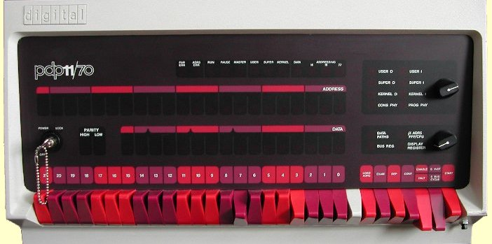
The Minicomputer Era
Started by Digital Equipment corporation in 1963
The PDP-5 was Digital Equipment Corporation's first 12-bit computer
Followed by the PDP-8 and the hugely popular PDP-11
Culminating in the “mini-Mainframe” VAX-11/780
Transition from transistors to integrated circuits
Established open hardware architecture (slots)
PDP-11/70 Front Panel
The VAX-11/780
An Early PDP-8

Slide 15
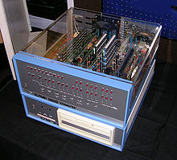
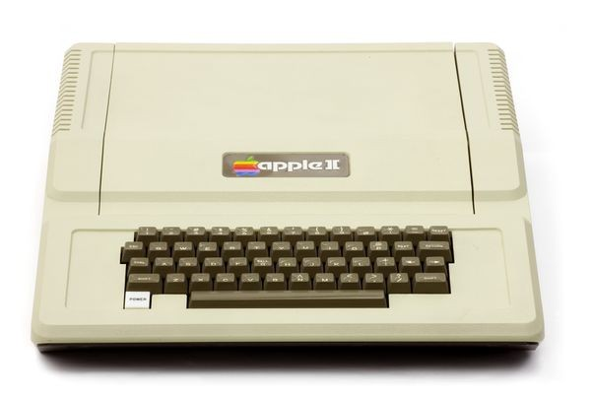
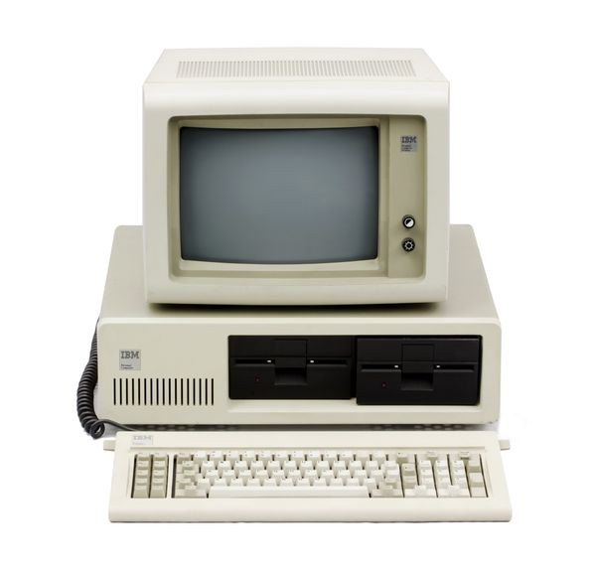
The Microcomputer Era
Integrated circuits allowed the creation of the first microprocessor, the Intel 4004, in 1971
Microprocessors were first used for embedded controls, but still required separate memory, I/O, etc
First microcomputer was the MITS Altair 8800, a DIY kit in 1974, using the Intel 8080
Followed by the IMSAI-8080 and many others
Followed by the Motorola 6502 based Apple I, then Apple II
And then the IBM-PC in 1982
The famous Apple ][
The IBM-PC
The Altair 8800

Slide 16
The Market Mitosis – Part 1
Microcomputers
Use microprocessors
Designed for use by people
General purpose
Use packaged programs (applications)
Will have human-friendly (somewhat) display and keyboard
Are designed and priced for business and consumer use
Embedded Controllers
Use microprocessors
Are part of industrial machinery
Specific purpose
Run only a single program for a single task
Minimal or no human interface
Are designed and priced for industrial use

Slide 17
The Market Mitosis – Part 2
If all the elements of a microcomputer are put on a single silicon chip, you have a System-on-a-Chip (SoC)
SoC’s were the logical development for embedded microprocessor systems
But why not use an SoC to build something a human could interact with?
If the SoC is configured for controlling electrical signals, we have a microcontroller (aka uC)
If the SoC is configured for providing the functions of a traditional computer, we have a Single Board Computer (SBC)
These two functions define a non-exclusive spectrum

Slide 18
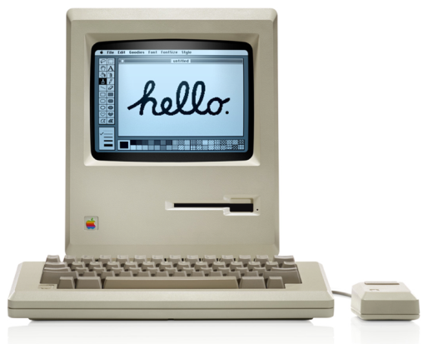
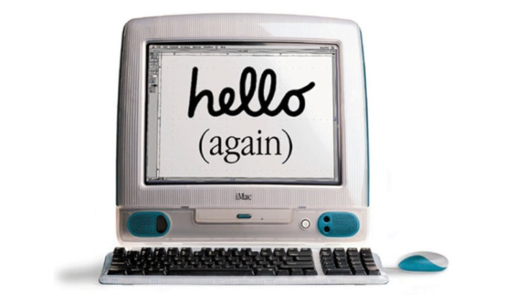
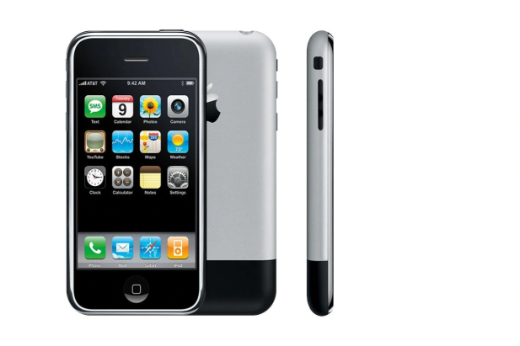
Microcomputer Evolution
Moore's law is the observation that the number of transistors in a dense integrated circuit (IC) doubles about every two years. Moore's law is an observation and projection of a historical trend. Rather than a law of physics, it is an empirical relationship linked to gains from experience in production.
From Gordon Moore, co-founder of Fairchild Semiconductor
From the IBM-PC onwards, microcomputers continued to get exponentially smaller, faster, and much more powerful due to Moore’s law
As processor power increased, Graphic User Interfaces (GUIs) became possible
From desktops we went to laptops
And from laptops we went to smart phones
The Macintosh 128K
The all-in-one iMac
The iPhone 1

Slide 19
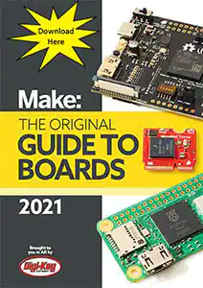
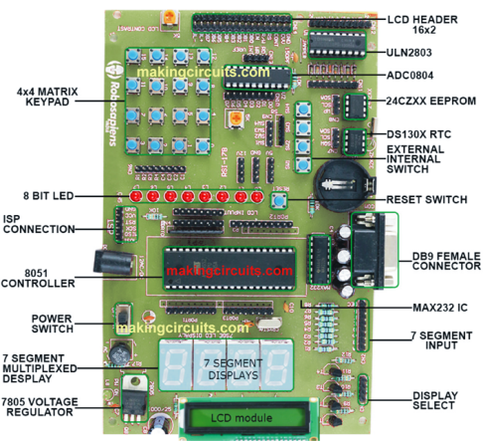
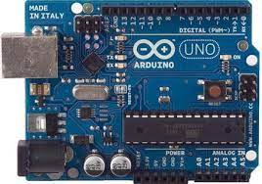
Microcontroller Evolution
Originally microprocessors with separate memory, I/O
As chip transistor density increased, it become possible to integrate all components onto an SoC
SoCs evolved from embedded systems to user-accessible
An SoC microcontroller made in a user-accessible format is called a microcontroller board or just “board” for short
All boards offer General Purpose I/O (GPIO) pins which do a variety of things
First and most famous user accessible microcontroller is the Arduino Uno
We now have hundreds of microcontroller boards to choose from
See https://makingcircuits.com/blog/types-of-microcontroller-boards-and-their-applications/ for details and examples
An embedded microcontroller
The Arduino Uno
The Make/Digi-Key Boards Guide

Slide 20
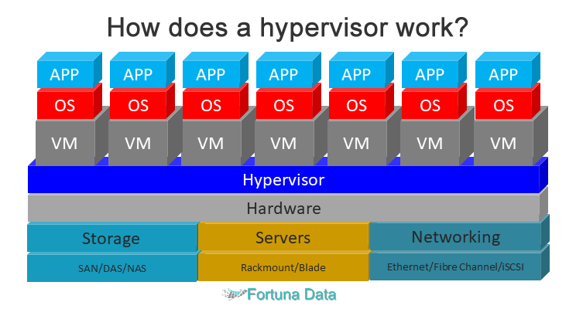
Final Word – Mainframe Evolution
Virtualization – technology to model computer hardware in software, allowing one to “run” an entire computer as a piece of software
A computer emulated in software is a Virtual Machine (VM)
Originally developed by IBM in the 1970’s as an operating system to run VM’s
Revolutionized by the development of the hypervisor
Cloud computing is based on and requires virtualization and hypervisors
A hypervisor, also known as a virtual machine monitor or VMM, is software that creates and runs virtual machines (VMs). A hypervisor allows one host computer to support multiple guest VMs by virtually sharing its resources, such as memory and processing. -- Wikipedia

Slide 21
Formal End of Lesson 2.1
In next week’s exciting episode
Setting board types
Loading Example Sketches
Finding and selecting the Arduino USB port
Uploading a sketch
The parts of an Arduino sketch
History of Telecommunications and Networking

Slide 22
Extra Credit?

Slide 23
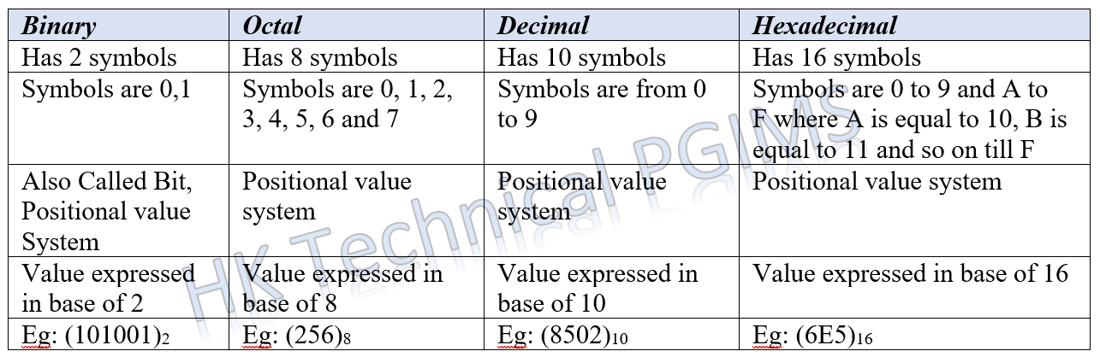
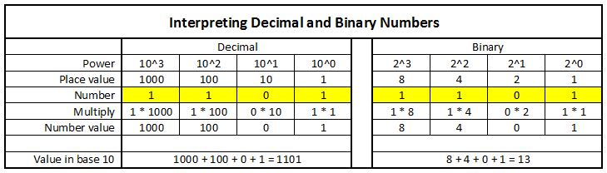
Binary Number System
Used by all computers since the 1950’s
Allows electronic logic gates (transistors) which can only be on or off, to represent numbers (1 or 0)
Logic gates can be wired together to perform mathematical operations
The math operations performed by the logic gates can be expanded to perform real-word functions: display and printing alphanumeric characters, controlling lights, sensing movement, etc.
Binary numbers are usually represented hexadecimal, and sometimes octal, number systems, which are more convenient for representing binary than the decimal system
This will be studied next semester as part of software programming
We will not study binary this semester, but you are strongly urged to self-study this material before next semester (Software Programming)

Slide 24
Recap Slides from Lesson 2

Slide 25
USB Flash Drive Inventory
DOCUMENTATION – Arduino Reference
Programming with Arduino.pdf
Arduino Cookbook-2ndEdition.pdf
Arduino-For-Beginners-REV2.pdf
IntroArduinoBook-AlanSmith.pdf
IntroductionToArduino-Book-AlanGSmith.pdf
Make_Getting_Started_with_Arduino_3E.pdf
DOCUMENTATION – Electronics Reference
the-original-guide-to-boards-2021.pdf
Basic Electronics-Semiconductors.pdf
Grobs Basic Electronics 2010.pdf
Instructables-Basic-Electronics.pdf
Intro to Electronics-Noisemantra.pdf
Make Electronics 2nd Edition by Charles Platt.pdf
SPIE-TT107-PracticalElectronicsforOpticalDesignandEngineering-Chapter1.pdf
DOCUMENTATION – WiFi Kit 32 Reference
Quick review: DC vs AC electric currents
WIFI_Kit_32_Schematic_diagram_V2.1.PDF
HeltecWifiKit32-ReferenceURLs.txt
WIFI_Kit_32_pinoutDiagram_V2.1.pdf
DOCUMENTATION – Boards Guides
Original Boards Guides from 2019-2022
DOCUMENTATION – Class Information
SEICHE-IntroToArduino-Lesson1-V1.pdf
IntroductionToArduino-ElectronicsKitInventory-TextFormatWithDescriptions.txt
IntroductionToArduino-LessonPlan-8Dec21-V1-PLF.pdf
SEICHE-ArduinoClass-Summary-V1.txt
SEICHEArduinoKitInventory-Brief.txt
Critical Documents
Make Getting Started With Arduino – Use this for self study and back reference
Arduino Cookbook 2nd Edition – Use this for reference and advanced study
Make Electronics 2nd Edition – Use this for self study and back reference
Heltec WiFi Kit 32 Pinout – Maybe print this out since you’ll be referring to it often
Boards guides – If you want to select and purchase a board for your own use
Electronics Kit Inventory – To keep track of items or if you think you may have lost something
RETURN FLASH DRIVES AT END OF EACH LESSON
I’ll load new content each week, at least that week’s lesson but also sketches

Slide 26
Windows – CP2102 Driver Installation
Navigate to software folder on USB drive
Open Windows folder, then folder for your OS
Open Release Notes and follow the instructions
We can walk through some installs, and screen share if desired so everyone can see how this works
MacOS X probably doesn’t need a driver install, but it’s on the USB if needed
Kubuntu does not need an install, drivers are in kernel
Believe it or not, this is probably the trickiest part of the entire class
If you are at all not sure what you’re doing, or what Windows version or architecture you’re using (e.g. x86 vs x64) then wait for assistance

Slide 27
Arduino IDE Installation
Navigate to software folder on USB drive
Open folder for your OS
Windows you can double click the installer
MacOS X drag Arduino.app to your Applications folder
Kubuntu
Open Konsole
Enter “lsblk” to find your USB drive
Enter “tar xvf usbdriveidentifier/Software/Linux/arduino1.8.19-linux64.tar”
Enter “cd arduino1.8.19-linux64”
Enter “sudo ./install.sh” and enter your password when prompted
WE WILL DO BOARD SETUP NEXT WEEK
If you are not sure what you’re doing, then wait for assistance or ask for help
(This part is not as tricky as the CP2102 driver installation)

